Slide 1
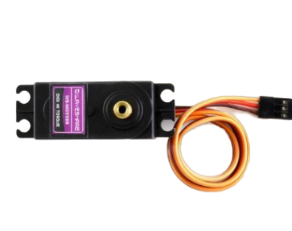
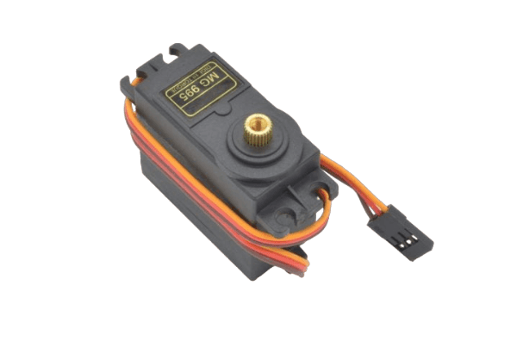
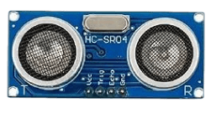
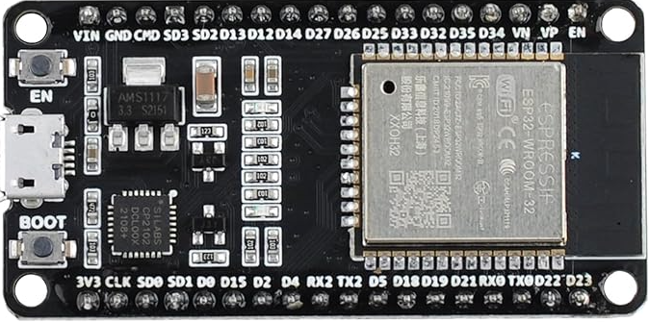
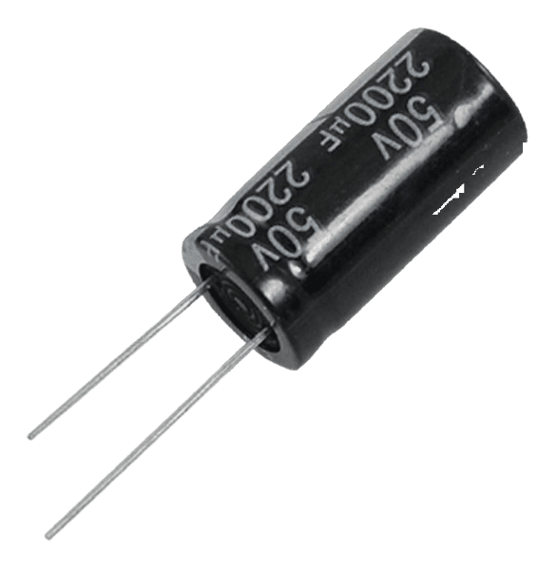
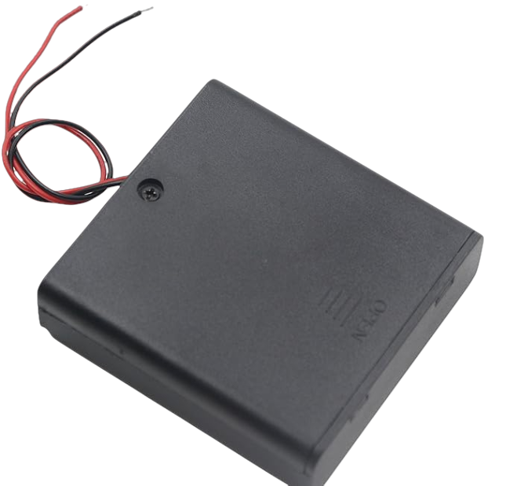
ESP32 Devkit V1
MG996 Servo
MG996 Servo
MG995
Servo
HC-SR04 Ultra-Sonic
Sensor
50V 2200uF
Capacitor
6V Battery

Slide 2
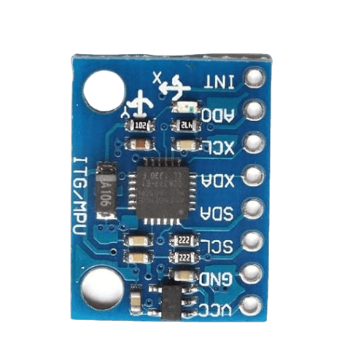
MG995 Servo
MG995 Servo
MG995 Servo
MG995 Servo
ESP32 Devkit V1
6V Battery
MPU6050 IMU
50V 2200uF
Capacitor

